Slide 1

STUDENT FINANCIAL HABIT ANALYSIS
By
Aaron Otomofa

Slide 2
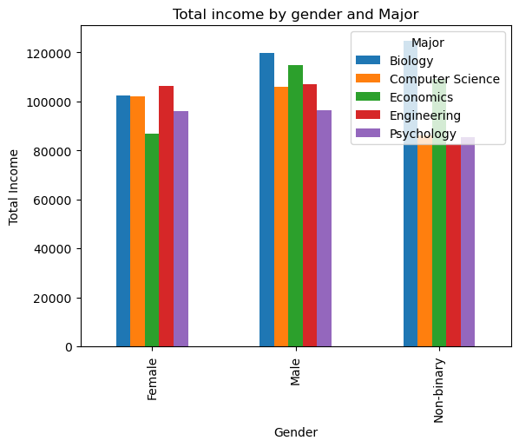
TABLE OF CONTENT
PROBLEM STATEMENT
OBJECTIVES
INSIGHTS
RECOMMENDATION
CONCLUSIONS

Slide 3

PROBLEM STATEMENT
The analysis aims to gain insights into the spending habits of students’ universities and relationships between these variable and to identify trends and patterns in the spending habits of students. It aims at Exploring Student Financial Behaviors.

Slide 4
OBJECTIVES
This project aims to uncover patterns in students spending behaviors and to uncover the financial habits.
Key Objectives includes:
To Determine the major with the highest tuition fee
To determine the major with the highest total expenses (sum of all expenses except tuition).
To Determine the expenses incurred by each Age group.
To estimate the income of student across various levels.
To investigate the financial strain on the students for effective planning.
To uncover the most common payment method.
To uncover the age group of students in the various levels in schools.

Slide 5
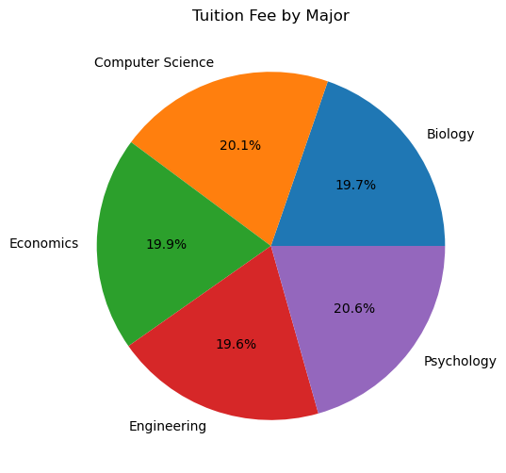
INSIGHTS AND FINDINGS
To Determine the major with the highest tuition fee
From the analysis, Engineering has the lowest Tuition fee, while psychology has the highest tuition fee.

Slide 6
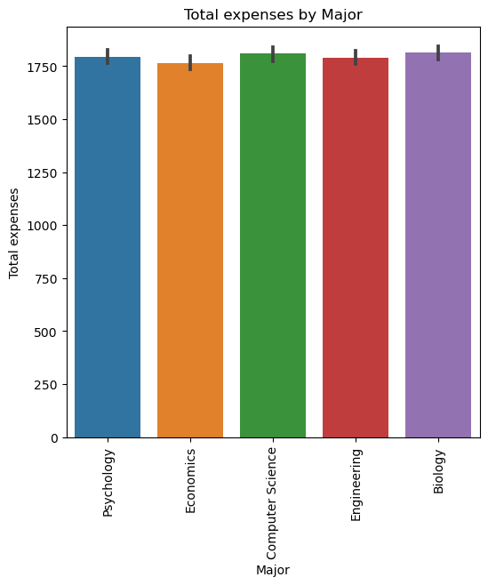
2.To determine the major with the highest total expenses (sum of all expenses except tuition).
it can be seen that biology incurs the highest total expenses while psychology has the lowest.

Slide 7
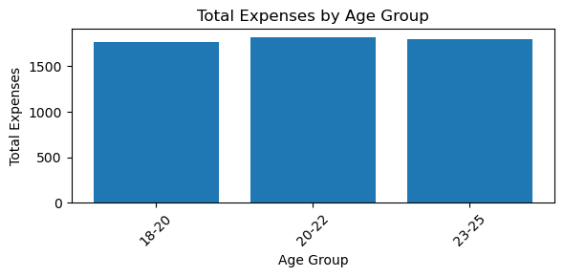
3. To Determine the expenses incurred by each Age group.
From the analysis above, the age_group 20-22, incurs the most expenses.

Slide 8
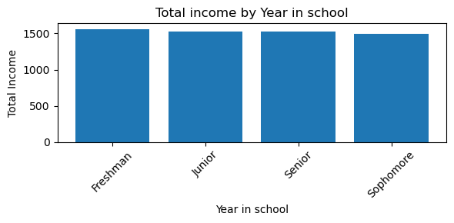
4. To estimate the income of student in various levels.
freshman have the highest income and sophomores have the lowest average income.

Slide 9
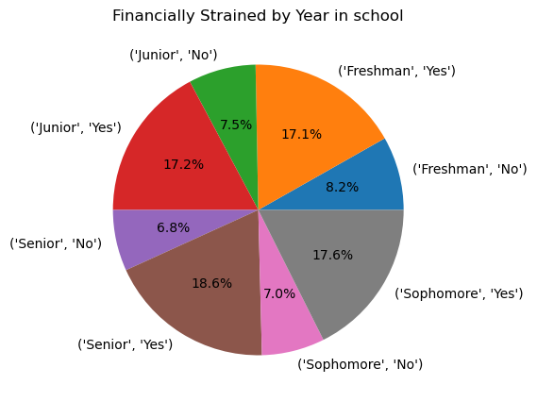
5. To investigate the financial strain on the students for effective planning.
Students in Senior, and 23-25 age group are mostly financially strained.
Also, in gender, male students are also mostly financially strained.
NB: financially strained students are those whose total expenses is higher than their total income. With yes being true and No being false.

Slide 10
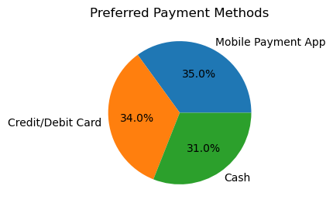
6. To uncover the most common payment method.
The most preferred payment method is mobile app payment, followed closely by credit/debit card.

Slide 11
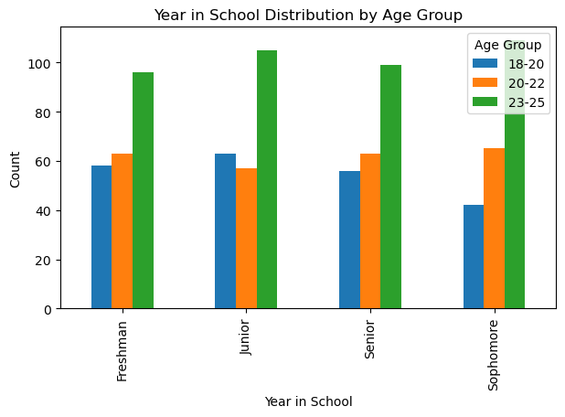
7. To uncover the age group of students in the various levels in schools.
The age goup of students in the various levels with 23-25 having the most population.

Slide 12
Conclusion
Findings:
Engineering has the least average tuition fee, while psychology has the highest.
it can be seen that biology incurs the highest total expenses while psychology has the lowest.
From the analysis above, the age_group 20-22, incurs the most expenses.
Also, in some certain majors like computer and biology students, 23-25 age group incurs the most expenses.
Freshmen have the highest income and sophomores have the lowest average income
Engineering major students have the highest income..
Students in Senior, and 23-25 age group are mostly financially strained.
Also, in gender, male students are mostly financially strained.
The most preferred payment method is mobile app payment, followed closely by credit/debit card.

Slide 13
Conclusion;
The analysis carried out on the dataset provides insights into the relationships between demographic, financial, and academic variables. The results can be used to inform policy decisions and resource allocation. Further analysis can be carried out to explore other research questions and hypotheses.

